Slide 1
Project Guide
IoT-BASED HARDWARE PROJECT
Mrs. B. Kalyani
Assistant Professor
Smart Battery
Management
System
Team Members
Ayush Sanjay 24P81A0403
B. Rakesh 24P81A0407
G. Vishal 24P81A0417
G. Dhanush 24P81A0422

Slide 2
Objectives
01
02
Measure voltage, current and temperature of the battery pack
Send the data between two ESP32 nodes over a CAN bus
03
04
Turn on the cooling fan automatically when the pack gets hot
Show live data and SoC / SoH on a Node-RED dashboard
Smart Battery Management System | 2

Slide 3
Introduction
Lithium-ion packs get damaged when voltage, current or temperature go beyond safe limits.
This project monitors a 3S Li-ion pack in real time using two ESP32 boards connected by a CAN bus.
One ESP32 reads the sensors and sends the data; the other receives it, controls a 12V cooling fan and feeds a Node-RED dashboard.
Smart Battery Management System | 3

Slide 4
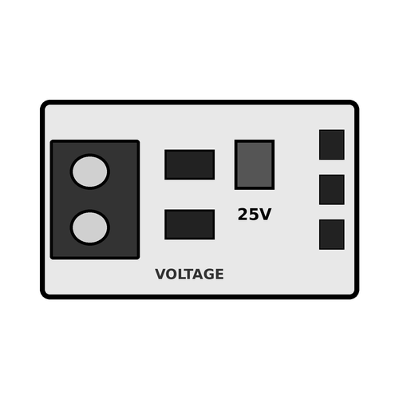
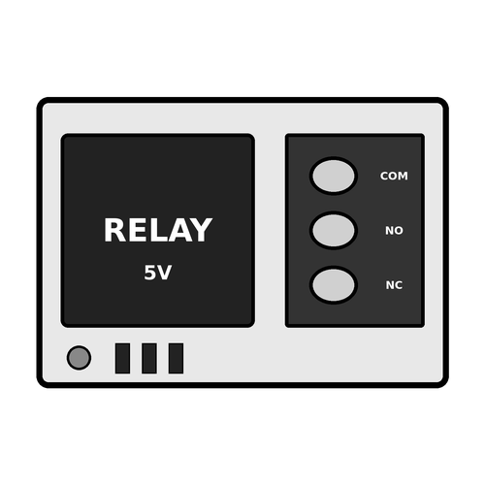
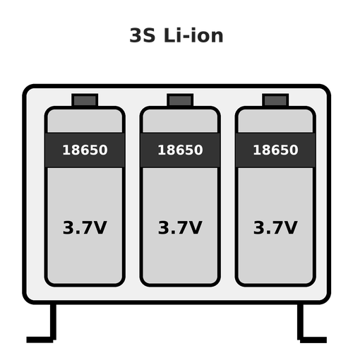
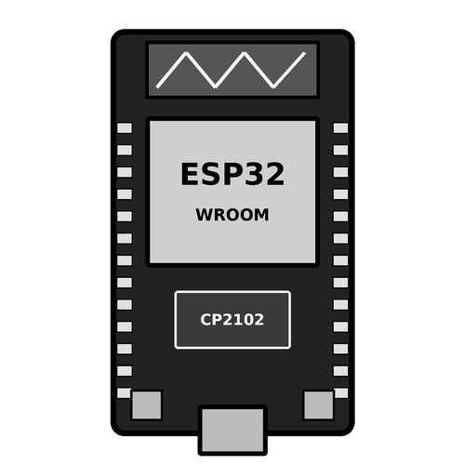
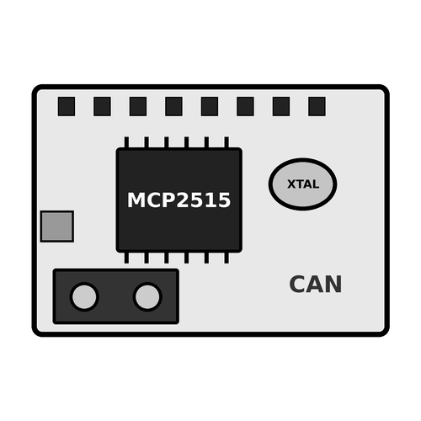
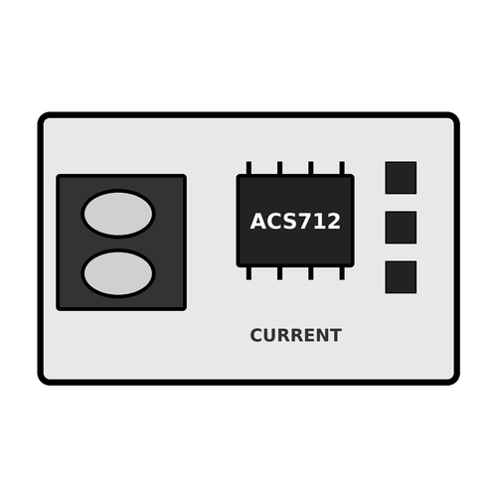

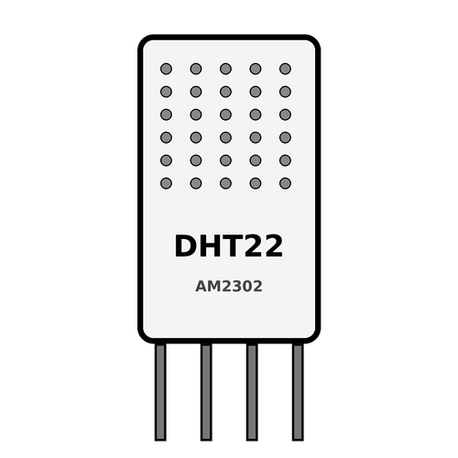
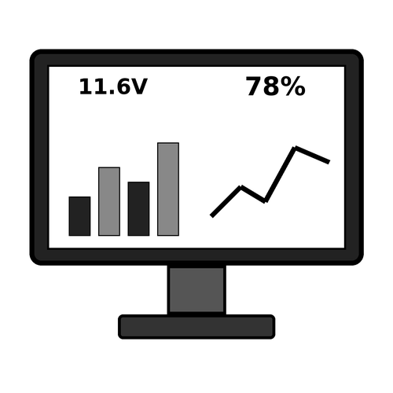
Block Diagram
CAN-H / CAN-L
Voltage Sensor
Relay Module
3S Battery Pack
ESP32 (TX)
MCP2515 CAN
MCP2515 CAN
ESP32 (RX)
ACS712 Current
12V Fan
(Cooling)
GPIO27
DHT22 Temp
Node-RED
Smart Battery Management System | 4

Slide 5
Components Required
ESP32 Dev Module (x2)
DHT22 Temperature Sensor
1
5
MCP2515 CAN Module (x2)
3S Li-ion Battery Pack
2
6
Voltage Sensor
5V Relay Module
3
7
ACS712 Current Sensor
12V DC Fan
4
8
Smart Battery Management System | 5

Slide 6
Working Principle
1
2
3
4
Sense
Transmit
Receive
Act
Read voltage, current, temperature
ESP32-TX sends CAN frames
ESP32-RX decodes the data
Fan control and alerts
Control Logic
Temp normal
Fan OFF
Temp 31°C or above
Fan ON
Voltage / current abnormal
Warning
Smart Battery Management System | 6

Slide 7
Node-RED Dashboard
ESP32-RX
Node-RED Flow
Dashboard
SoC / SoH Estimation
11.6 V
1.8 A
29.4 °C
78 %
92 %
Voltage
Current
Temperature
SoC
SoH
SoC = State of Charge SoH = State of Health (values shown are sample readings)
Smart Battery Management System | 7

Slide 8
Features, Applications & Future Scope
Key Features
Applications
Future Scope
Real-time monitoring
Reliable CAN communication
Automatic cooling
Live SoC / SoH dashboard
Electric vehicles
Drones and robots
Solar storage
Backup power units
Predictive alerts
Cell balancing
Multi-pack monitoring
Mobile app alerts
Smart Battery Management System | 8

Slide 9
Thank You
Smart Battery Management System

